Slide 1
Mixed Grain Intercrops:
The Value Proposition
South East Research Farm, Redvers SK
Lana Shaw, PAg, MSc
Research Manager
Elijah Leatherdale
Technician
Notes:
The South East Research Farm conducts a wide range of agricultural trials of relevance to the southeast region of Saskatchewan. SERF is a non-profit producer-directed research and demonstration organization. As such, the farm conducts projects and trials with a focus on improving productivity, sustainability, and diversity at the farm level. The research program has taken the approach that a diverse crop research program assists in creating agility in agriculture. New ideas that combine environmental sustainability, plant diversity and practicality are a feature of this program going into 2018. Staff and directors work closely to develop project ideas, find project funding, and conduct the projects efficiently.
For 2017, there were over 3000 plots seeded, which was a considerable increase from the previous year. Grain crop trials were done on many species and market classes of crops to enable producers to get local production knowledge on these crops. Intercropping research is breaking new ground and is of interest outside the southeast region. Where possible, SERF is partnering with other research locations to evaluate intercrops under different environmental conditions.

Slide 2
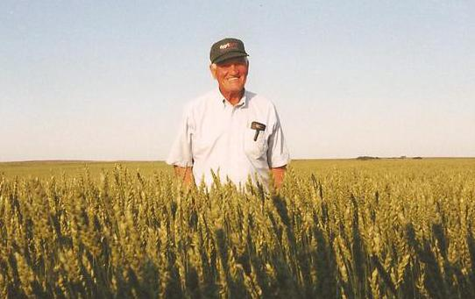
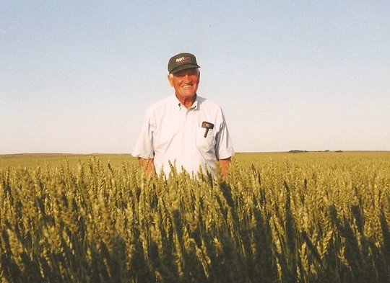
My Farming Roots
Grandpa Lawrence Wallis in one of his best crops, near Rosetown, SK

Slide 3
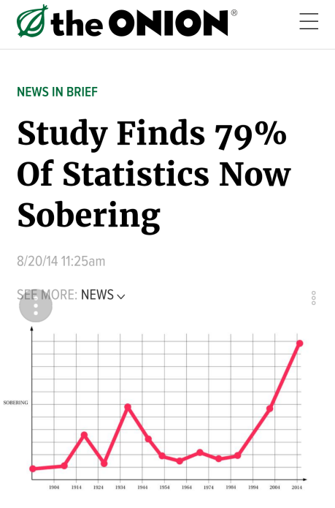
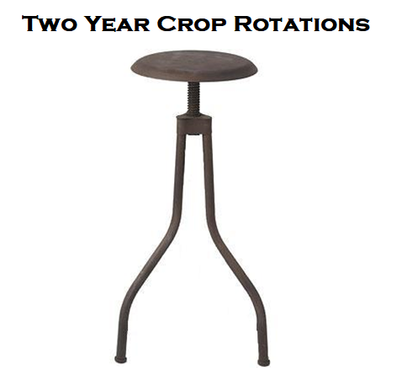

Slide 4
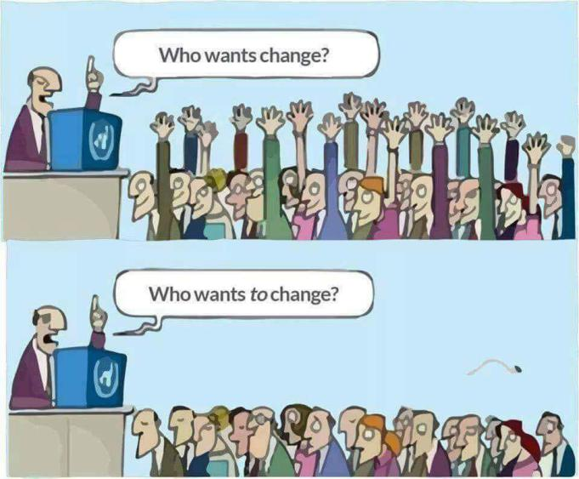
Intercropping is a big change!

Slide 5
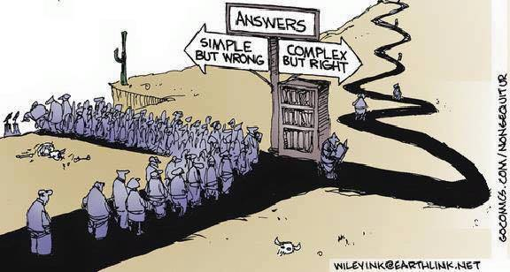
No Easy Answers on Intercropping

Slide 6
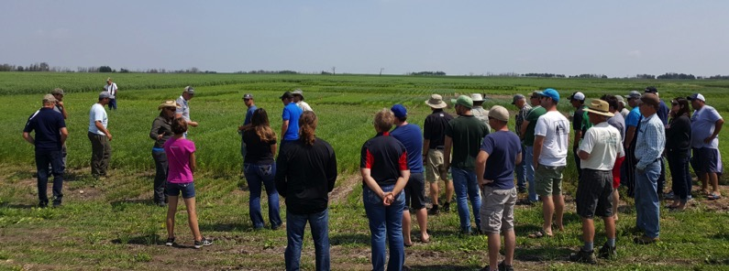
Intercropping Catch 22
Catch 22: A situation in which a desired outcome or solution is impossible to attain because of a set of inherently contradictory rules or conditions.

Slide 7
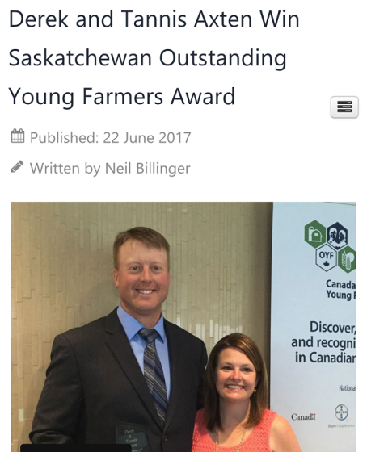
Farmers are leading the way!
Hybrid of organic and “conventional” techniques
“New Conventional”?
Sustainable Intensification
More profit

Slide 8
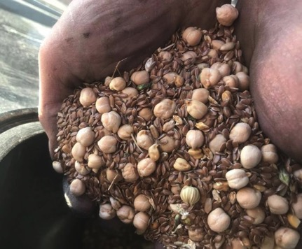
FAQ: Why Mixed Grain Intercropping?
Why not?
Obstacles are surmountable
Multiple observed benefits
  Productivity (yield)
  Pest Reduction
  Harvestability
  Nutrient Efficiency
  Risk Mitigation
  Ecosystem services?
Photo: Kurt Myllymaki, Montana, 2018

Slide 9
FAQ – Mixed Grain Intercrops
Is anyone actually doing this?
  Yes. In SK, MB, AB, ND, SD. (see Twitter)
  SCIC – 32K ac 2018, 34K ac 2017
  Interest is huge

Slide 10
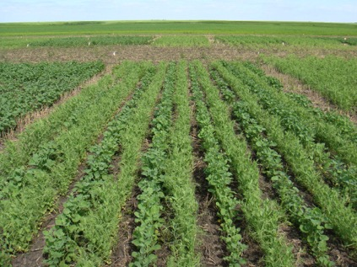
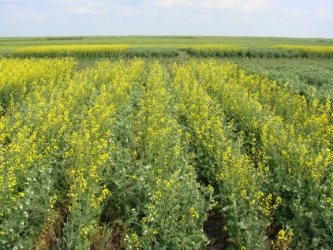



Intercropping Peas & Canola:
Row/Crop Configuration & N Fertility
Chris Holzapfel, IHARF
Scott Chalmers, WADO

Slide 11
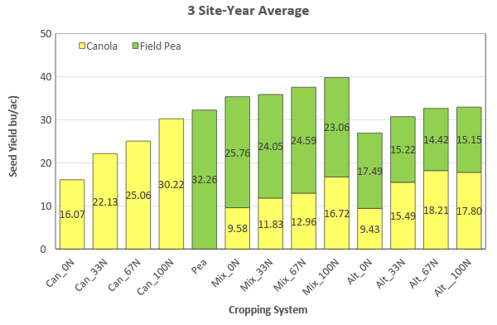
Row Crop Orientation X N Fertilizer Rate
Seed Yield (average)
39.8
35.9
37.6
35.4
32.6
32.9
30.7
26.9

Slide 12
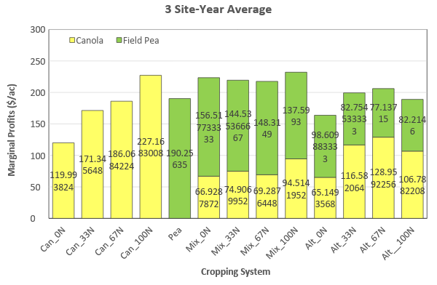
Row Crop Orientation X N Fertilizer Rate
Marginal Profits (average)
$223
$232
$219
$218
$199
$206
$189
$164

Slide 13
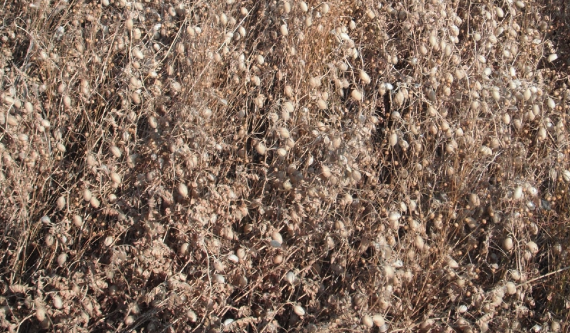
October 2012 – SERF Intercrop
The yield was 1500 lb/ac of harvested chickpea.
New Strategy for Mixed Grains:
Use less competitive, higher value, hard to grow crops in combinations.
Use seed rate and fertility to pick a main crop and a companion (pick a winner).
Area of crop economic, agronomic adaptations can change.

Slide 14
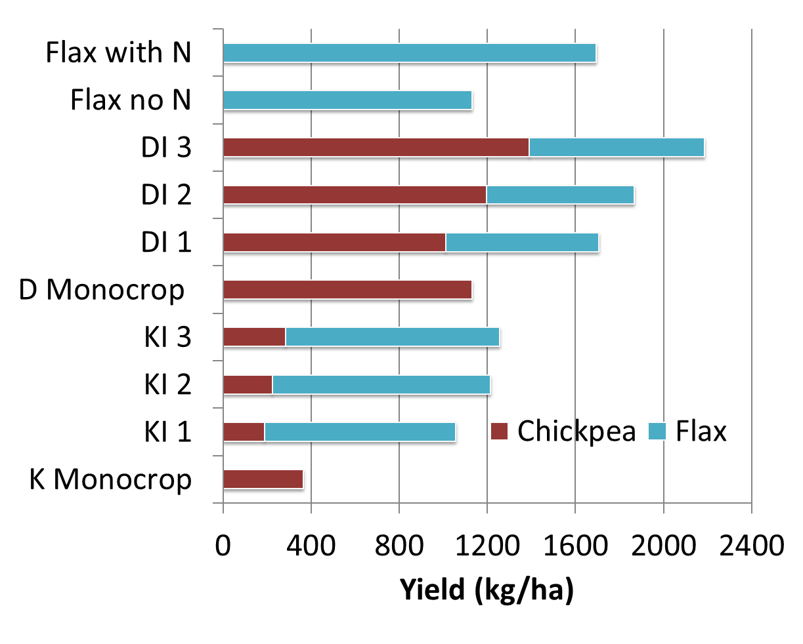
2013 Redvers Chickpea Flax (ADOPT)

Slide 15
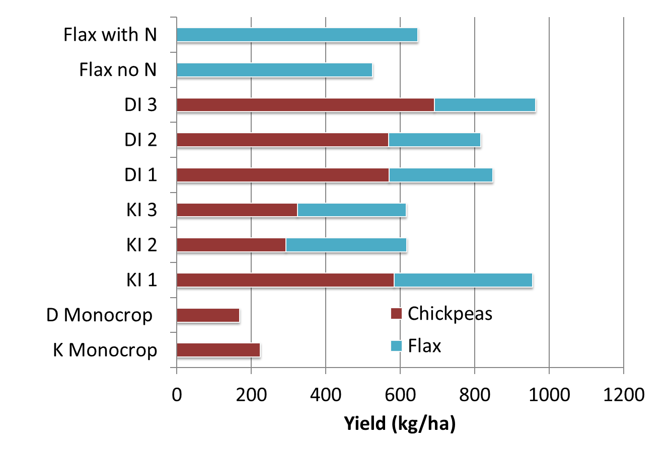
2014 Redvers Chickpea Flax (ADOPT)

Slide 16
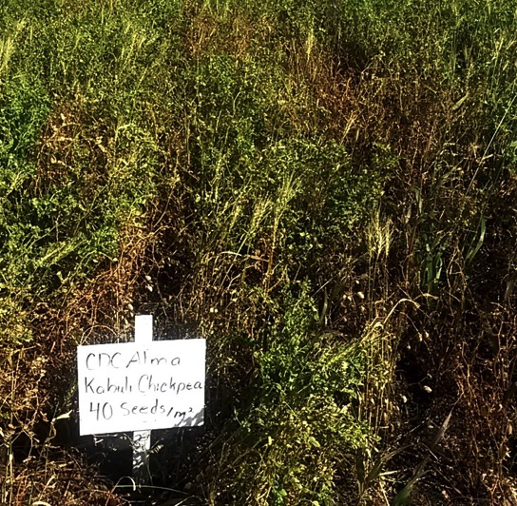
Redvers 2014
Disease incidence was reduced in intercrop plots
Chickpea Aschocyta Incidence on Aug 30 (% severity):
51% for monocrop plots
17% for intercrop plots
Significant difference

Slide 17
High Flax, Mixed, No N
Wide Mono Chickpea, No N

Slide 18
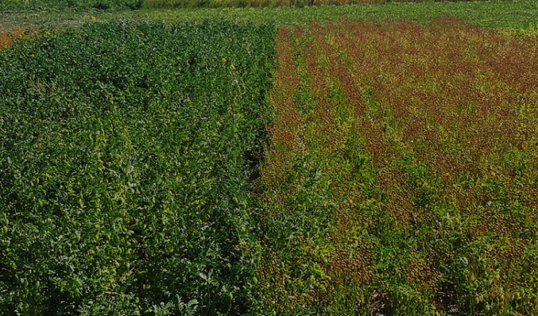
Chickpea Flax (2017 Redvers)

Slide 19
Sask Pulse Trials:
Indian Head and Redvers 2017
Less green seed in yield sample
More even senescence (Indian Head) and shortened maturity (Indian Head and Redvers)
1000 kg/ha (18 bu/ac) flax in intercrops added to value
Profitable combined yield of chickpea and flax
  > 2000 kg/ha combined on average, around $600/ac (old chickpea prices)
Stable yields, profitable production

Slide 20
Chickpea Flax Intercrop
Best Advice So Far
Start with small acreage
Target monocrop chickpea density
Flax rate 10-20 lb/ac (preliminary), do strip trials for local verification
Chickpeas thresh the flax bolls
Intercrop compensates, lowers risk (esp. in wet areas)

Slide 21
Chickpea Flax Intercrop
Best Advice So Far
Use Sulfentrazone (Authority)
Field selection: low N, fairly clean, cereal stubble if conventional
Seed at different depths (esp if dry)
Be prepared to use dessicant or stripper header as needed

Slide 22
Green Lentil – Mustard
(SPG Trial)
2017 Redvers Trial
  2200 lb/ac Green Lentils
  (95% of monocrop Green Lentil yield)
  300 lb/ac bonus mustard
  More crop value
  Easier to harvest, taller

Slide 23
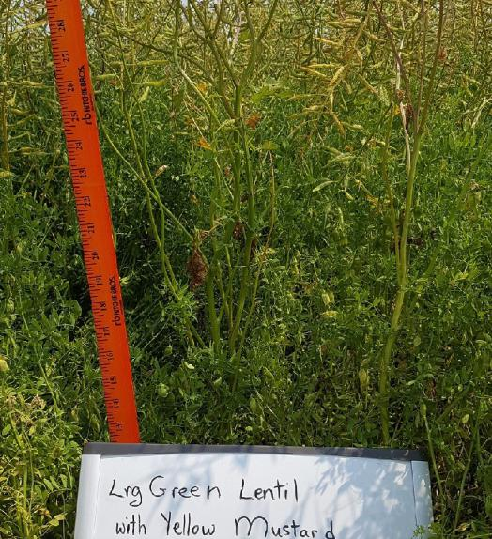
Large Green Lentil – Yellow Mustard
Not Lodged

Slide 24
SPG Pulse – Mustard 2017

Slide 25
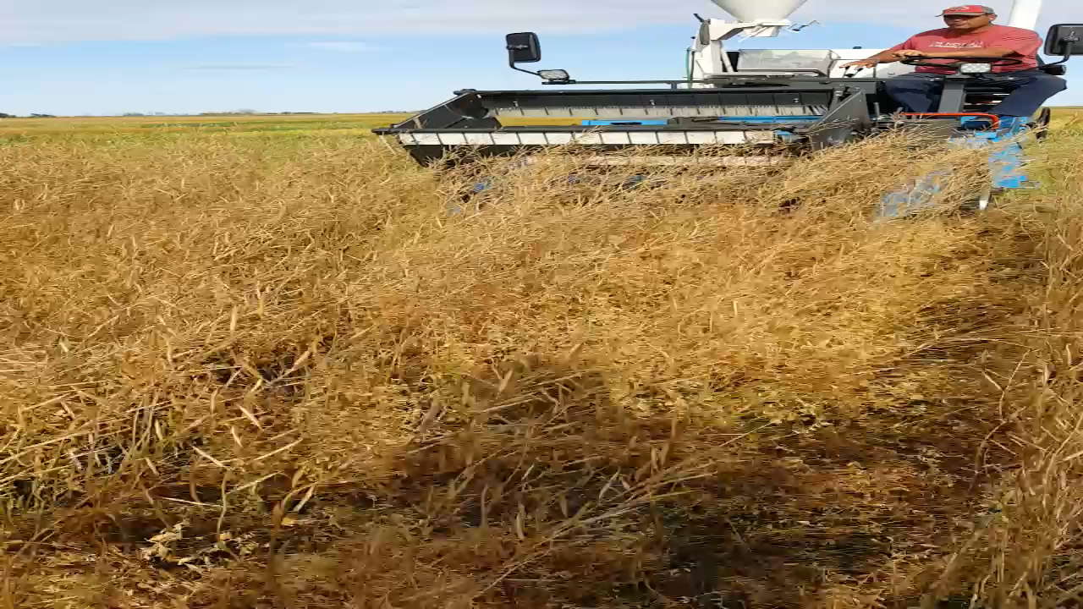

Slide 26
SPG Pulse – Mustard 2017
Treatment | Lentil Yield | Mustard Yield | Lentil Yield | Mustard Yield | Total Yield | Crop Value
 | (lb/ac) | (lb/ac) | Partial LER | Partial LER | Full LER | $/ac
GLentil Monocrop | 2311 | 0 | 1 | 1 | 1 | 393
GLentil Ymust | 2207 | 337 | 0.96 | 0.46 | 1.42 | 490
GLentil Bmust | 2106 | 360 | 0.91 | 0.37 | 1.29 | 473
YMust Monocrop | n/a | 726 | n/a | 1 | 1 | 217.66
BMust Monocrop | n/a | 962 | n/a | 1 | 1 | 240.41
Prices Updated for 2018.
Full 2017 report available from Sask Pulse Growers website.

Slide 27
Triple Crop – Ymust, Lentil, Pea
Lentil monocrop - $117 to $510 /ac
Pea monocrop - $13 to $103 / acre
Mustard Monocrop - $266 to $336 / acre
Intercrops - $193-$331 /ac
Best Intercrop Trt - 40 b/ac N (vs 0 and 20 lb/ac added)
Poor N fixation due to Aphanomyces

Slide 28
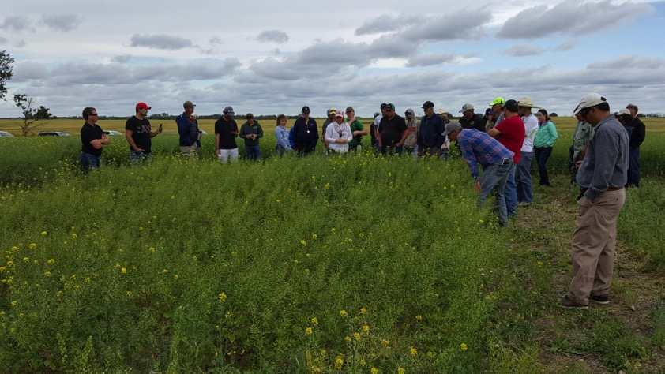
Hat Trick Intercrop
(Mustard, Pea, Xsmall Green Lentil

Slide 29
Triple Intercrop - 2018
Treatment | Total Yield (lb/ac) | $/acre Gross Value | Land Equivalency Ratio
Pea Mono | 471 | 51 | 1
Lentil Mono | 1508 | 241 | 1
Mustard Mono | 1269 | 267 | 1
InterLow | 1121 | 190 | 1.1
InterMed | 1337 | 223 | 1.4
InterHigh | 1501 | 246 | 1.7

Slide 30
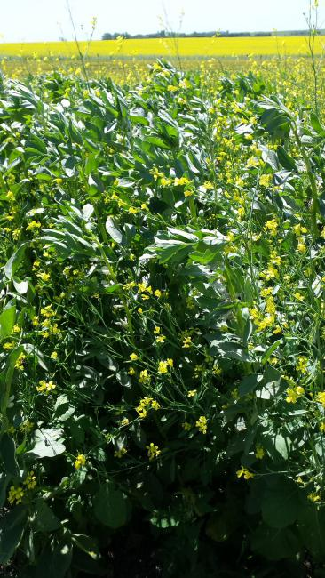
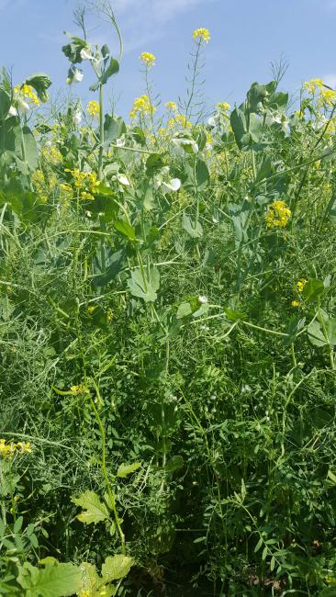

Slide 31
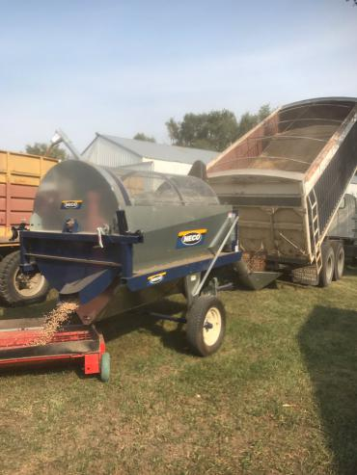
How do you separate it?
  Large seed size difference is important
  Dockage cleaners have capacity
  Custom basic cleaning $.50 - $1/bu

Slide 32
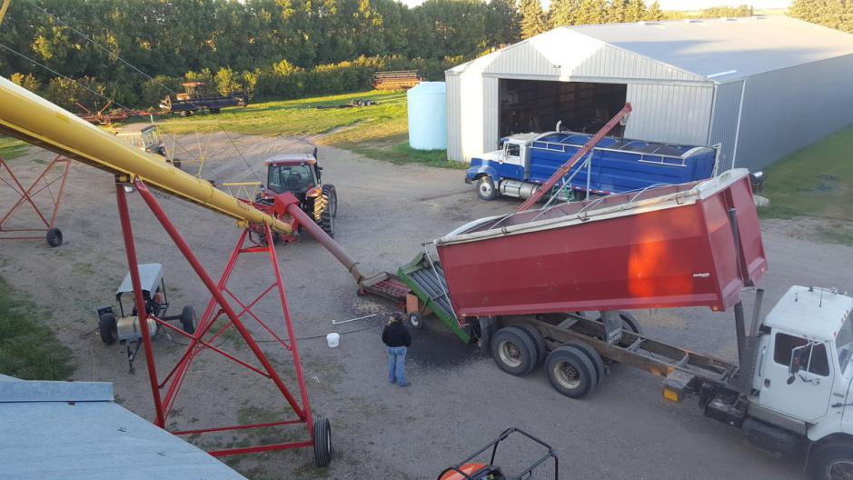
David Ediger, MB: KwikClean set-up

Slide 33
Mixed Grain Intercrops
If not here, where?
  Flax, mustards, camelina
  Diverse pulses: chickpea, lentil, faba, pea
  Local markets and handling facilities
If not now, when?

Slide 34
What is the Value Proposition?
Depends on the crop combination
Look at all benefits to risk, workload, production cost
Higher yield is only part of the story
Effects on harvestability, maturity, disease pressure

Slide 35
#IntercropInnovators
Recognizes farmers as leaders in intercropping (not lip service)
Researchers working peer to peer with farmers
Researchers need to have their farmer hat on
Social media connectivity pushing forward
Connecting innovation globally

Slide 36
Intercrop Innovators Workshops
Nov 21, Regina (Sk Ag Event)
Twitter info #IntercropInnovators
#IntercropInnovators = Supportive grassroots community

Slide 37
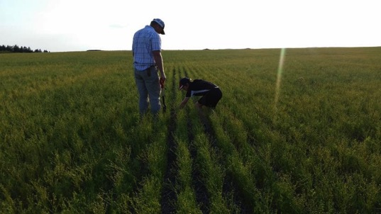
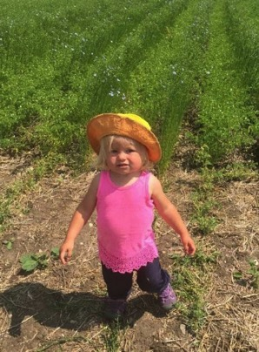
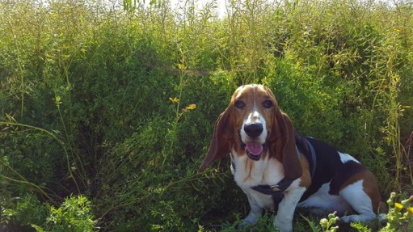

Slide 38
South East Research Farm Inc.
Redvers, Saskatchewan
Lana Shaw – SERF Research Manager
(306) 452-7253
lshaw.serf@gmail.com
Thanks to Sask Pulse Growers, Agri-ARM program, ADOPT, Government of SK
Twitter: SE_ResearchFarm
#IntercropInnovators

